Slide 1





Cartagena Protocol on Biosafety
20 Years of the Safe Use of Biotechnology
Secretariat of the Convention on Biological Diversity https://bch.cbd.int/protocol/

Slide 2









Presentation Outline
Part 1:
What is the Protocol on Biosafety? Part 2:
How does the Protocol work? Part 3:
Why is it important? Part 4:
Concluding Remarks

Slide 3












PART 1:
What is the Protocol on Biosafety?
An agreement between different countries
Negotiated under the Convention on Biological Diversity (CBD)
Adopted 29 January 2000 after 4 years of intense negotiations
Entry into force: 9 September 2003
173 ratifications/ accessions
10 meetings of the governing body (COP-MOP)
Next COP-MOP: 2024, Columbia

Slide 4

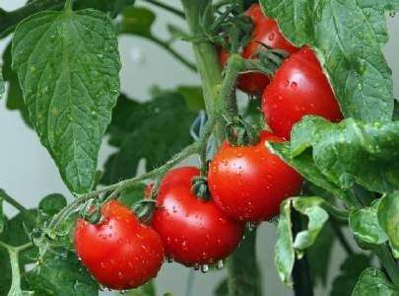








Objective
To contribute to ensuring the safe transfer, handling and use of LMOs resulting from modern biotechnology that may have adverse effects on the biological diversity, taking also into account risks to human health

Slide 5

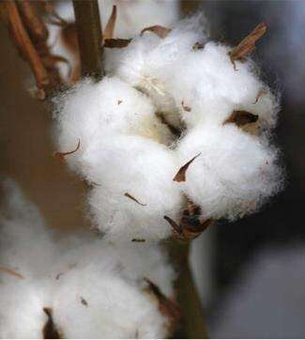








Scope
Applies to:
Transboundary movement, transit, handling and use of all LMOs that may have adverse effects on biodiversity, taking also into account risks to human health
Exclusion:
Pharmaceuticals for humans that are addressed by other international agreements or organizations

Slide 6



For millennia, farmers have selected and saved their best seeds and animals for breeding so that future varieties and breeds would have better qualities in terms of size, taste, growth rate or yield.
In recent years, new techniques, referred to as modern biotechnology, have allowed scientists to modify plants, animals and microorganisms at rates faster than those of conventional methods
They can extract genes from one organism and inserting them into another, resulting in living modified organisms (LMOs)

Slide 7







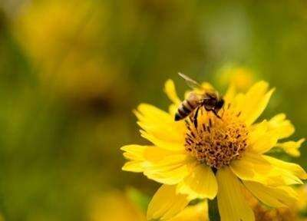


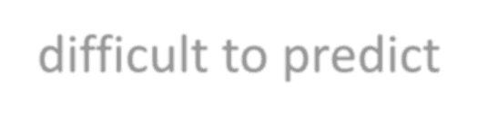




Modern biotechnology promises to improve human wellbeing, for example, by enhancing agricultural productivity
However, there are concerns about the potential risks that LMOs may pose to biological diversity and to human health
Environmental concerns (examples)
Impacts on non-target organisms
Transfer of genes from cultivated species to wild relatives Potential to become super weeds
Ripple effects within ecosystems – difficult to predict
Health concerns (examples) Potential allergenicity Antibiotic-resistance

Slide 8
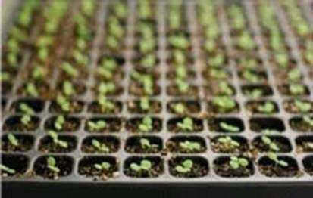
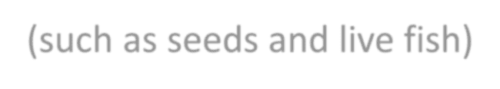







LMOs for intentional introduction into the environment (such as seeds and live fish)
LMOs intended for direct use as food, feed or processing, LMOs-FFP (such as agricultural commodities – corn, canola and cotton)
LMOs for contained use (such as bacteria for laboratory scientific experiment)

Slide 9















PART 2: How does the Protocol work?
The Protocol establishes rules and procedures to regulate the movements of LMOs from one country to another
Some of the measures include:
Risk Assessment –scientific, case by case
Safe handling, transport, packaging and proper identification of LMO shipments
Information sharing through Biosafety Clearing-House (BCH)
Capacity-Building
Public Awareness and participation
Compliance procedures and mechanisms
Liability and redress

Slide 10









































Key Provisions of the Protocol
Precautionary Approach
Objective: Safe Transfer, Handling and Use of LMOs
Rules/ Procedures:
AIA Procedure
Procedure for FFP
  Decision -
making
Risk Assessment
Risk Management
Handling,
Transport, Packaging and Identification:
- Documentation for Shipment
- Standards
Information Sharing
  Public Awareness &
Public
Participation
Supporting Mechanisms:
Biosafety Clearing-House (BCH), Capacity-Building, Compliance and COP-MOP

Slide 11
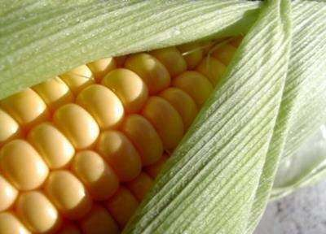






Procedures for Transboundary Movements of LMOs
There are two key procedures:
The Advance Informed Agreement (AIA) procedure Procedures for LMOs intended for direct use as food, feed or for
processing (LMOs-FFP)

Slide 12












































Key procedures
Possible Transboundary Movement of LMOs
For intentional release into environment
For food, feed or processing (FFP)
FFP Procedure:
-Approval for domestic use
-Import decision under domestic framework or Risk assessment/ Annex III
AIA Procedure:
-Notification
-Acknowledgement
-Decision based on
-Risk Assessment
Public Participation
Socio-Economic Considerations
BCH
Review of Decision
Final Decision
Requirements for safe handling, transport, packaging and documentation
Transboundary Movement if approved
New information
Monitoring
Risk Management

Slide 13





PART 3: Why is it important?
The Protocol is a key agreement contributing to biodiversity conservation and sustainable development
Biodiversity is the basis of human wellbeing
As biodiversity declines, so too does the Earth’s capacity to
support human life
All humanity must safeguard biodiversity from all threats and to stop or reduce its loss

Slide 14





Concluding remarks
Several LMOs have been placed on the market
It is important to ensure LMOs have no negative effects on biological diversity and human health
The Protocol establishes procedures and mechanisms for doing so The CPB recognizes the potential of biotechnology if developed and used
with adequate safety measures
Biosafety is concern for all humanity. Every individual has a responsibility and a role to play in ensuring that LMOs do not adversely affect biodiversity and human health.

Slide 15
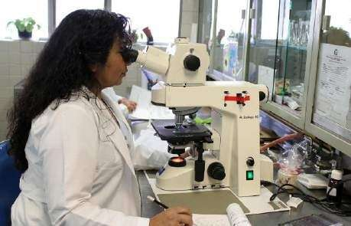


Biosafety is concern for all humanity
Every individual has a responsibility and a role to play in making sure that living modified organisms do not negatively impact biodiversity and human health

Slide 16






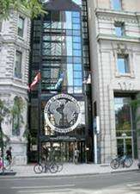












Contacts for Further Information
Secretariat of the Convention on Biological Diversity 413 Saint-Jacques Street, suite 800
Montreal, Quebec Canada H2Y 1N9
Tel.: +1 (514) 288-2220
Fax: +1 (514) 288-6588
E-mail: secretariat@cbd.int Protocol website: https://bch.cbd.int/protocol/ Biosafety Clearing-House: http://bch.cbd.int/

